Slide 1
Build predictive customer telco subscribed model with ANN
Rafif Dwiputra

Slide 2
OBJECTIVE
Build predictive customer telco subscribed model with ANN
DATASET
The dataset is used to predict the customer telco based on the product they have subscribe.

Slide 3
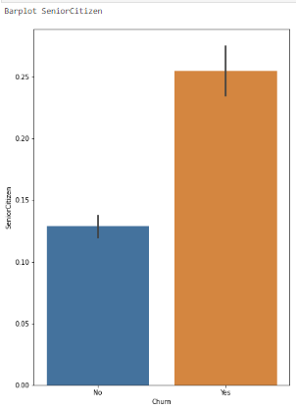
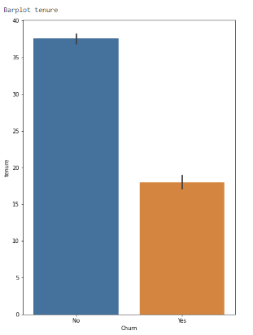
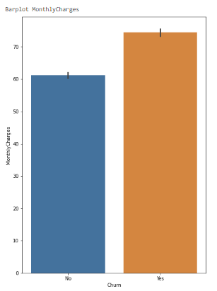
Numerical eda
Senior Citizen
Tenure
Monthly Charges
from the SeniorCitizen column, the highest number of Customer Churn is labeled 1, namely senior citizen.
From the tenure column, the highest number of customer churns are customers who do not have tenure.
From a comparison of MonthlyCharges and churn, the highest number of customer churns are customers who have monthly charges

Slide 4
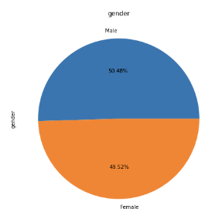
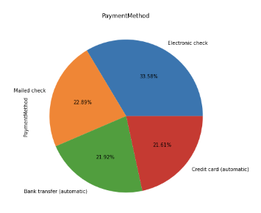
eda
from the piechart we can see that gender is dominated by men as much as 50.48%.
Payment Method is dominated by Electronic Check with 33.58% which means, customers prefer to make payments through electronic check

Slide 5
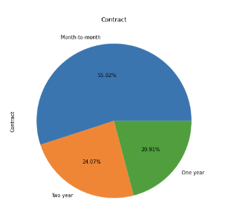
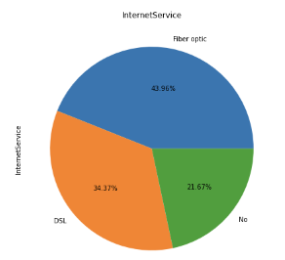
eda
Contract is dominated by Month to Month with 55.02% which means, customers prefer to have contract month to month than the one year or two year
Internet Service dominated by Fiber Optic.

Slide 6
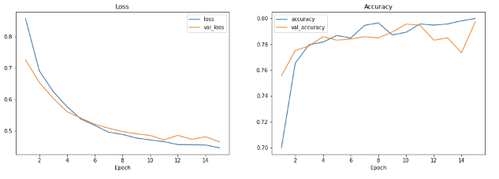
sequential model
From the visual above we can see that Loss decreases in each epoch, and the gap is not too big. but in terms of accuracy it is found that it is not very good, where there is an increase but it is not stable

Slide 7
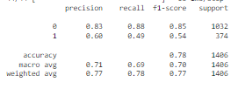
Classification report sequential api
In precision and recall for category 0 it is good, but in category 1 it is still underfit. Likewise with the accuracy which is only 79%

Slide 8
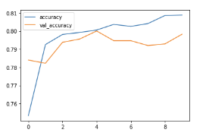
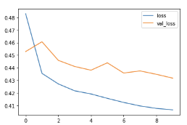
functional model
From the visualization above, it can be seen that the loss and accuracy are still not optimal, because the graph is getting wider and more irregular to the right

Slide 9
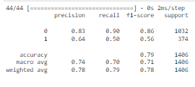
Classification report functional api
For the classification report, label 0 precision and recall have good values, 83% and 91%, but very much different from label 1 where only 66% and 47%. This indicates that the data is still underfitting. Judging from the accuracy, it only has 79% accuracy data

Slide 10
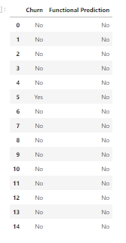

Model inference
The results of the inference model classification are quite good, where out of 15 inference data, 14 data can be predicted correctly.
The accuracy also reaches 93%, the precision for the 'No' label reaches 93% and the recall is 100%. For the 'Yes' label it is 0 because for the 'Yes' label in the data inference there is only 1 data.

Slide 11
SUMMARY
From the experimental results using 2 models, namely, Sequential API and Functional API, it was found that Sequential API is better at predicting data than Functional API.
After tuning the two models, it was found that the addition of a hidden layer alone was not enough to make the model even better, as well as the addition of epochs.

Slide 12
THANK YOU

